Slide 1
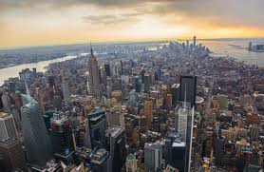
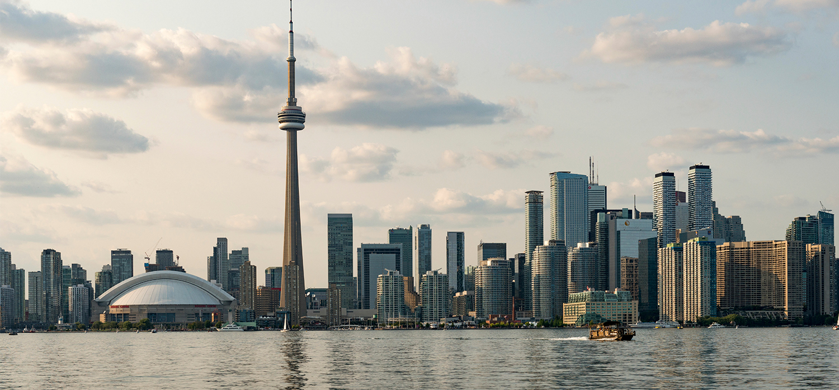
Toronto City Vs Manhattan City
Coursera Capstone Project

Slide 2
Why and What to Compare???
To find better options for the newcomers
To get better places to visit for the travelers
To get better ideas or scopes to invest for the inverters/entrepreneurs
What should be compared??
Peoples preference
Available resources
Cultural or historical aspects

Slide 3
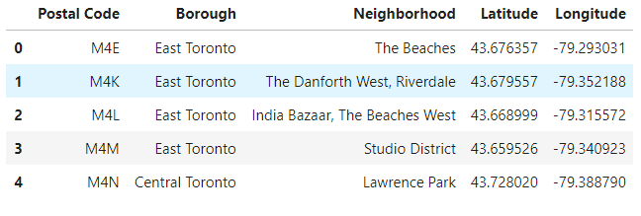
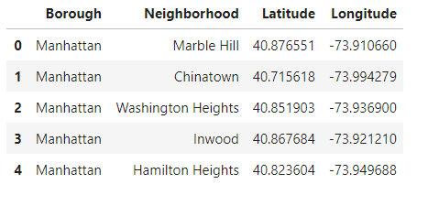
Data collection & Cleaning
The data collection has been done from the following sources:
https://en.wikipedia.org/wiki/List_of_postal_codes_of_Canada:_M
https://cocl.us/Geospatial_data
https://cocl.us/new_york_dataset
After proper cleaning, some samples of data:

Slide 4
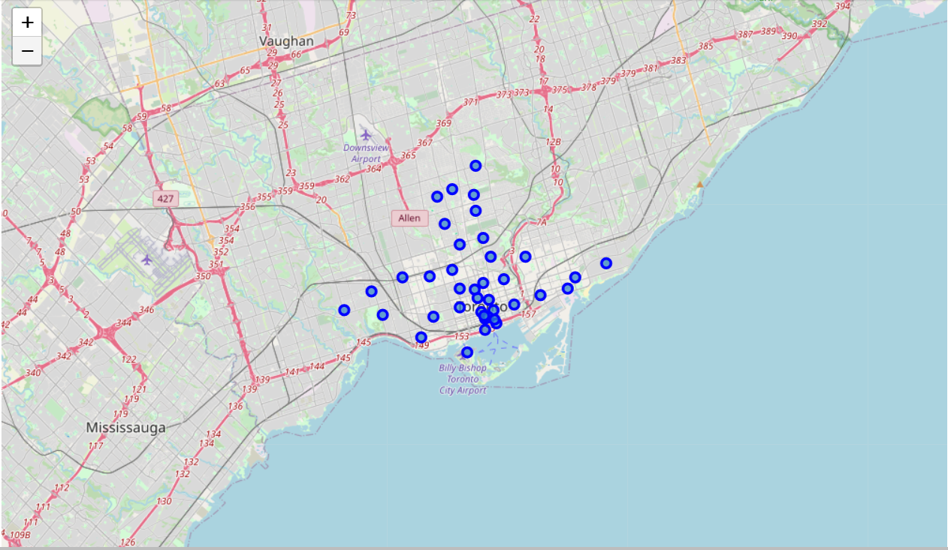
Exploring the neighborhood-Toronto City
The map has been developed
using folium library indicating some neighborhoods around Toronto city

Slide 5
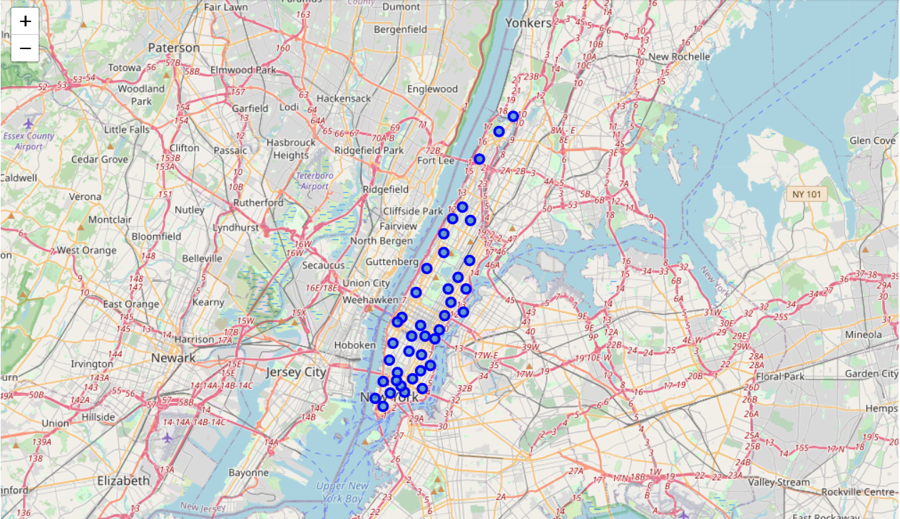
Exploring the neighborhood-Manhattan City
The map has been developed
using folium library indicating some neighborhoods around Manhattan city

Slide 6
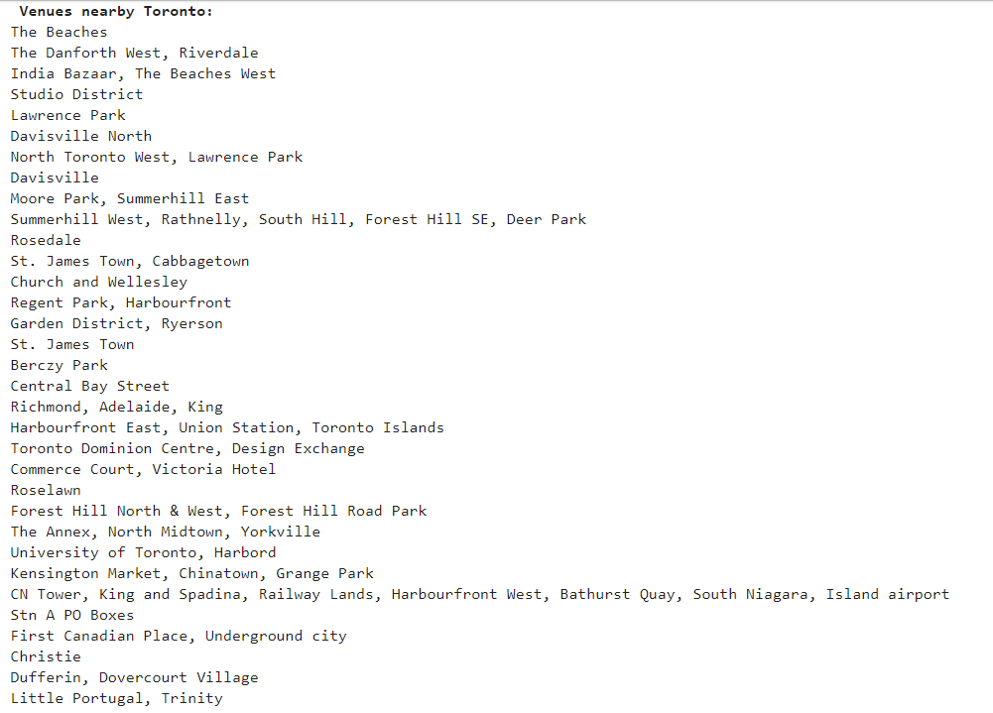
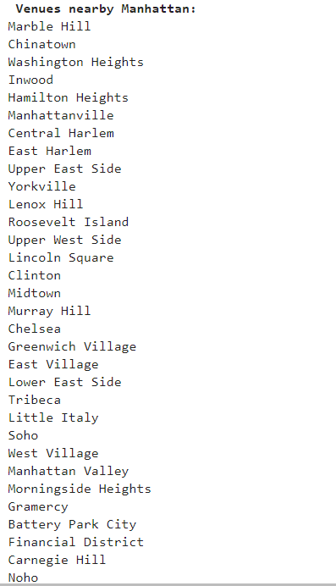
Some of the neighbourhoods
Neighborhood attributes has been found from The Foursquare API

Slide 7
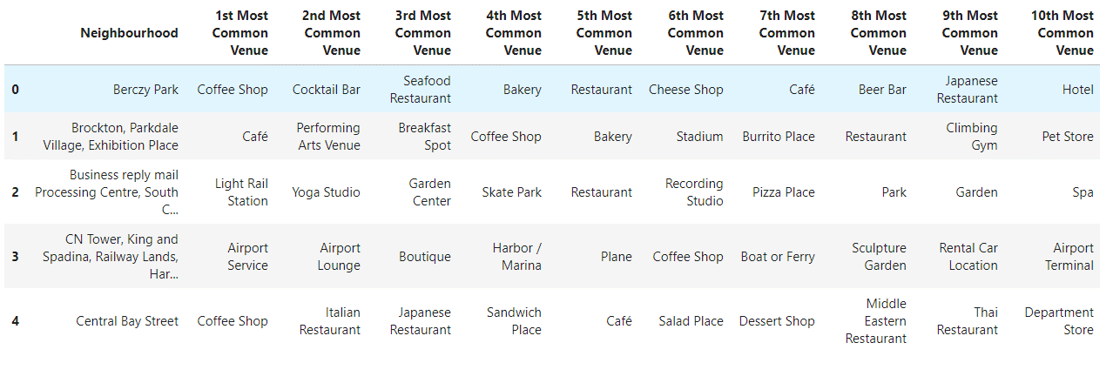
Neighborhood Venue Sorting
Each of the neighborhood's venues are sorted according to their popularity/frequency of peoples’ presence
Toronto Neighborhood:

Slide 8
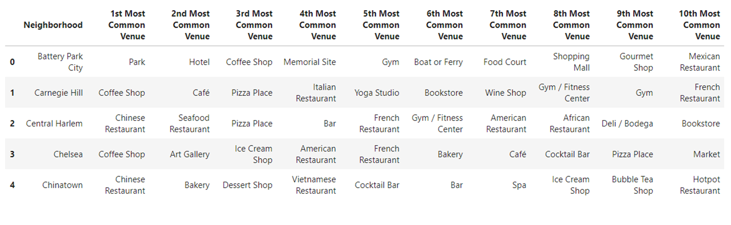
Neighborhood Venue Sorting
Each of the neighborhood's venues are sorted according to their popularity/frequency of peoples’ presence
Manhattan Neighborhood:

Slide 9
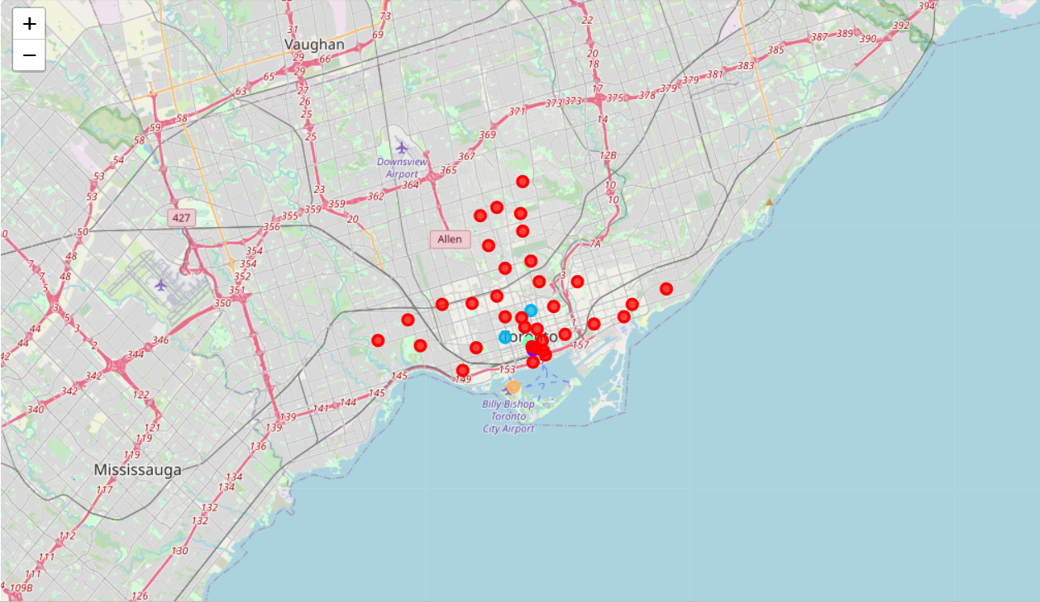
Clustering -Toronto
All the neighborhoods are clustered based on the popularity of the venues surrounding that.
Total cluster is 5
Color distinguished the clusters
Toronto cluster is less uniformed

Slide 10
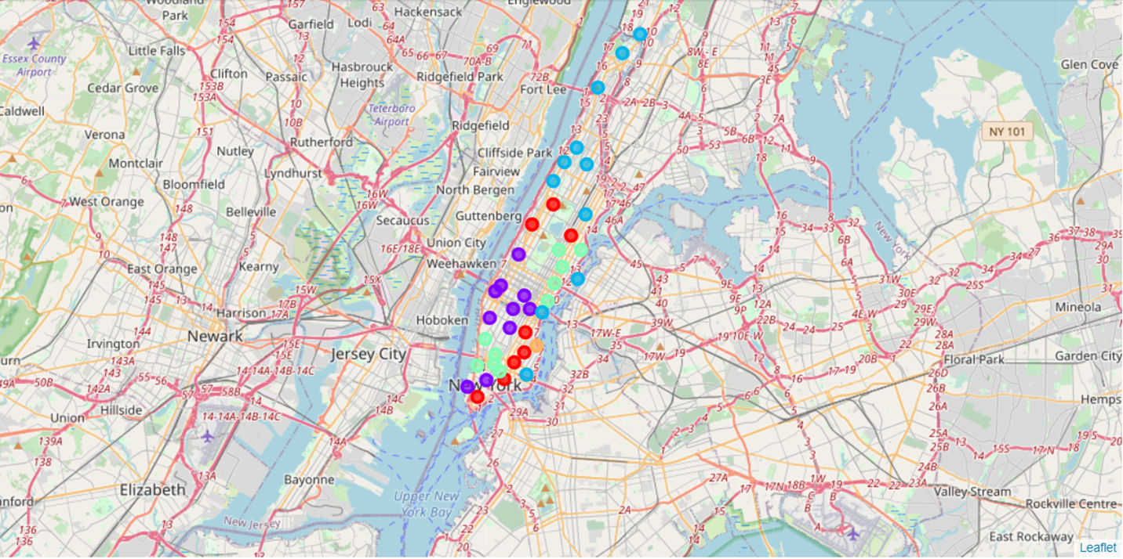
Clustering -Manhattan
All the neighborhoods are clustered based on the popularity of the venues surrounding that.
Total cluster is 5
Color distinguished the clusters
Manhattan cluster is more uniformed

Slide 11
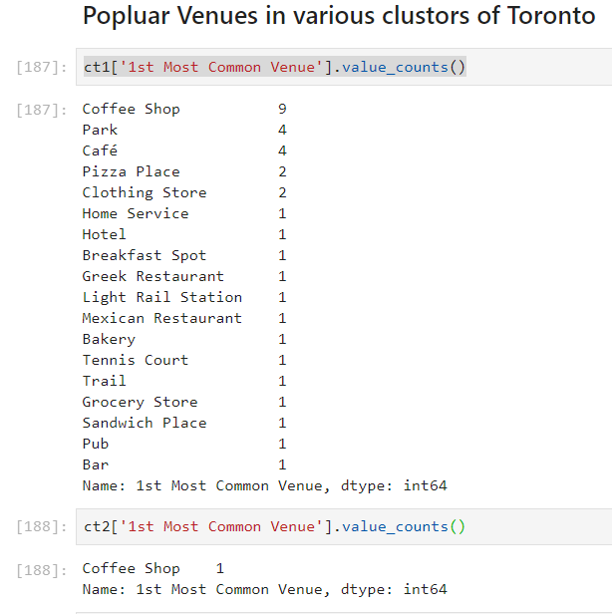
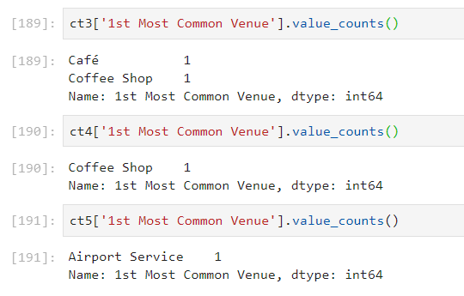
Comparison 1st common venues in different clusters of Toronto
Cluster 1 is well distributed, good for living
Other clusters 1st common venue doesn’t include basic regular thing i.e. grocery shops
Better option for investments in other clusters

Slide 12
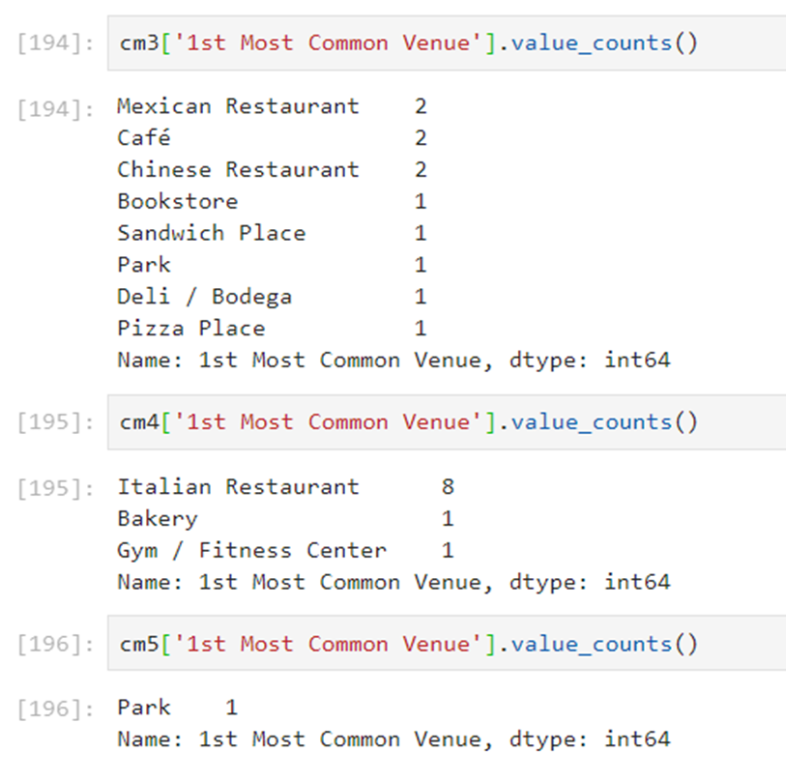
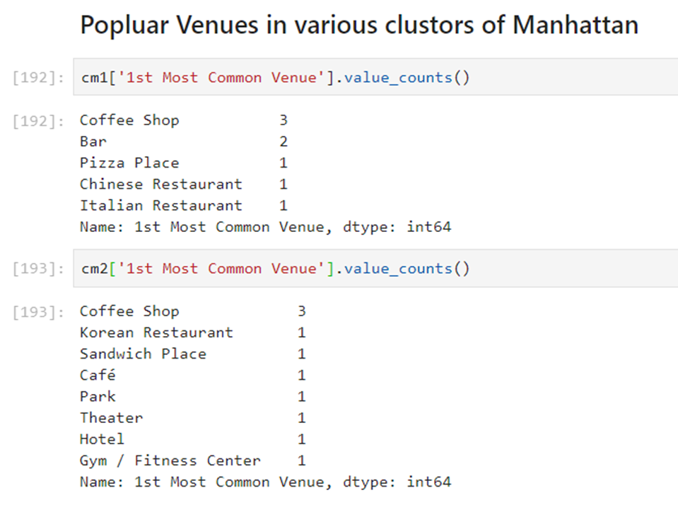
Comparison 1st common venues in different clusters of Manhattan
Cluster 3 is well distributed, good for living
None of the clusters 1st common venue doesn’t include basic regular thing i.e. grocery shops
Lots of Italian restaurants in these Neighbourhoods

Slide 13
Comparison & Conclusion
According to neighborhood considered, Manhattan city is mostly populated with restaurants compared to some regular stuff such as grocery whereas Toronto doesn’t have any 1st choice Italian restaurant.
The comparison with data helps decision making.
The comparison with data opens up opportunities for new scopes, ideas and improvement.

